Slide 1
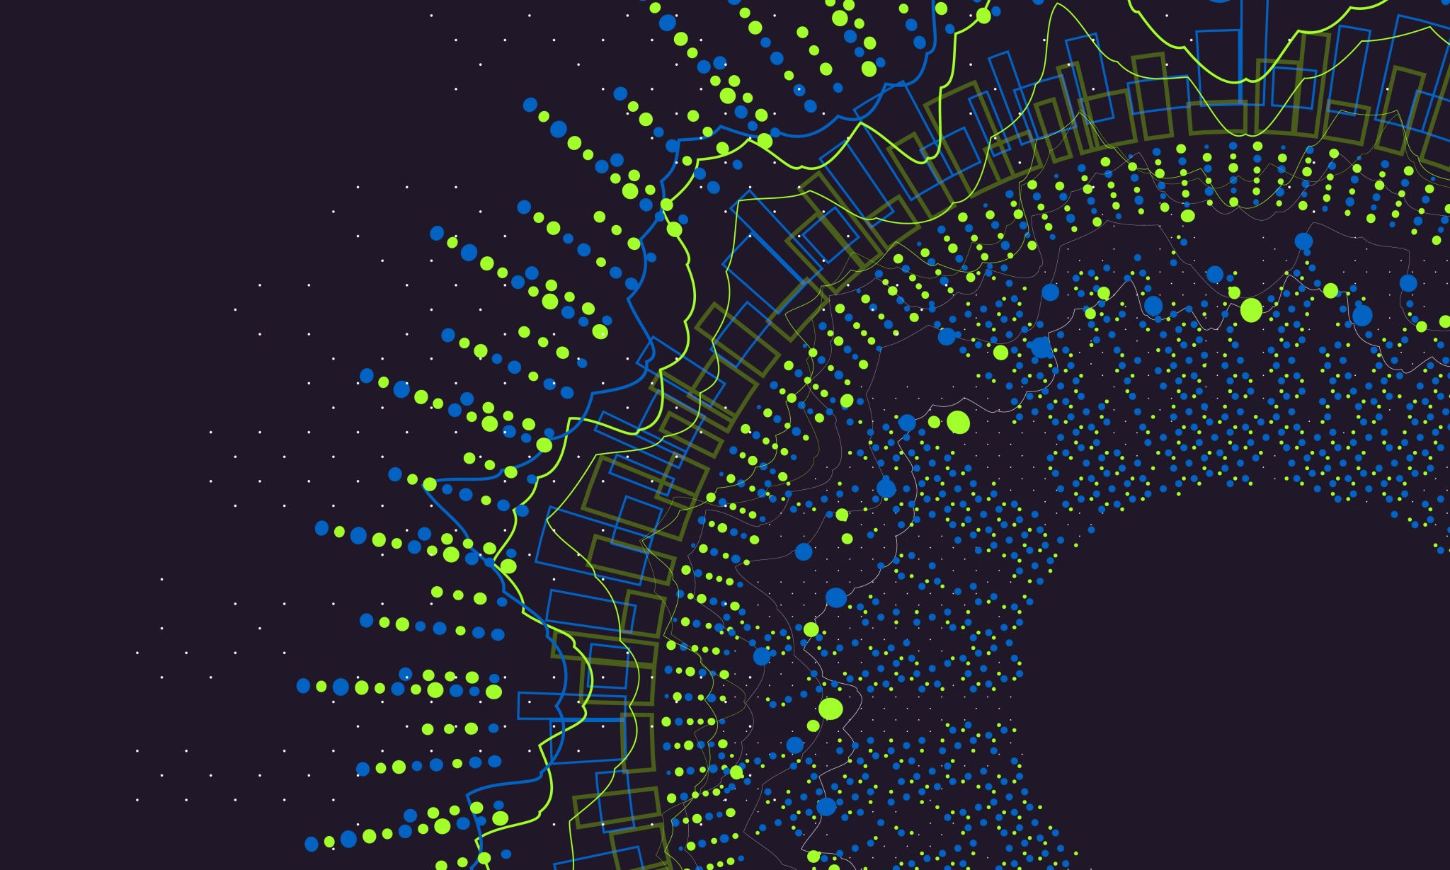
TOXIC COMMENT CLASSIFICATION
TEAM DEEP BLUE AI MAHE DUBAI
MEMBERS
GIRISH KUMAR MARPALLY
AFSAL
KAUSHIK
ABDUL QUADIR

